Slide 1
Menu review/ 4th Grade Gastronomy
Name: _________________Date: ____Class: 4th:___
Clase del 30 de Marzo al 3 de Abril
AE04: Reconocer y utilizar vocabulario de comidas en diferentes tipos de menú.
Instrucciones: Leer y completar PPT. Reenviar a su profesor de asignatura.
Sergio Masciocchi: smasciocchib@gmail.com

Slide 2
Ordering Food

Slide 3
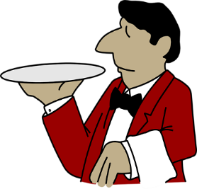
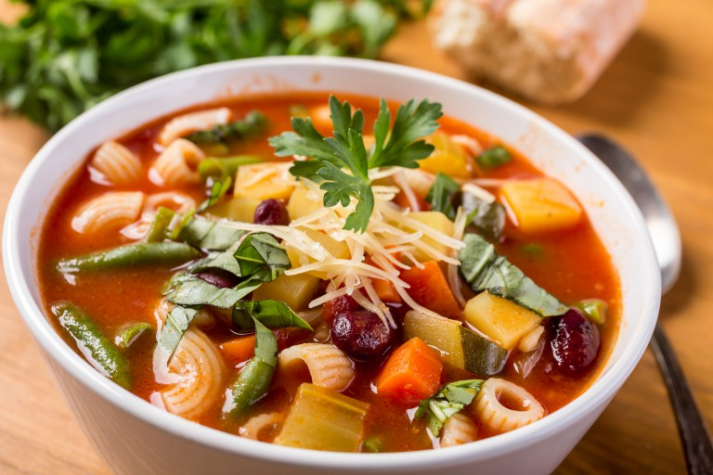
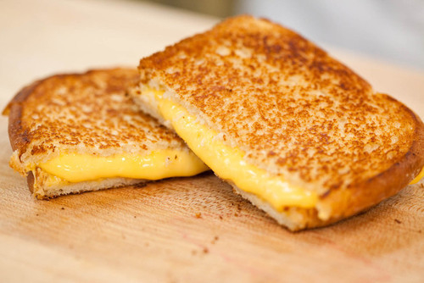
Waiter: Good afternoon. Are you ready to order?
Ann: yes, I’ll have a bowl of vegetable soup and a cheese sandwich.

Slide 4
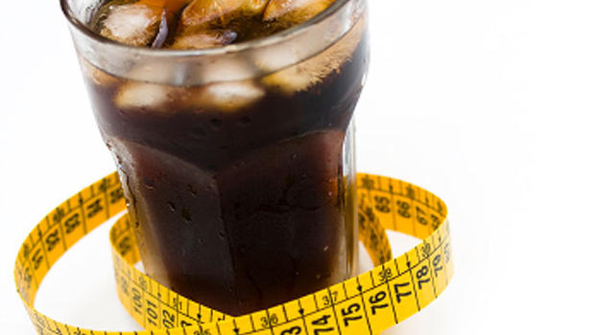
Waiter: Would you like anything to drink?
Ann: Yes, I’d like a glass of diet soda.

Slide 5
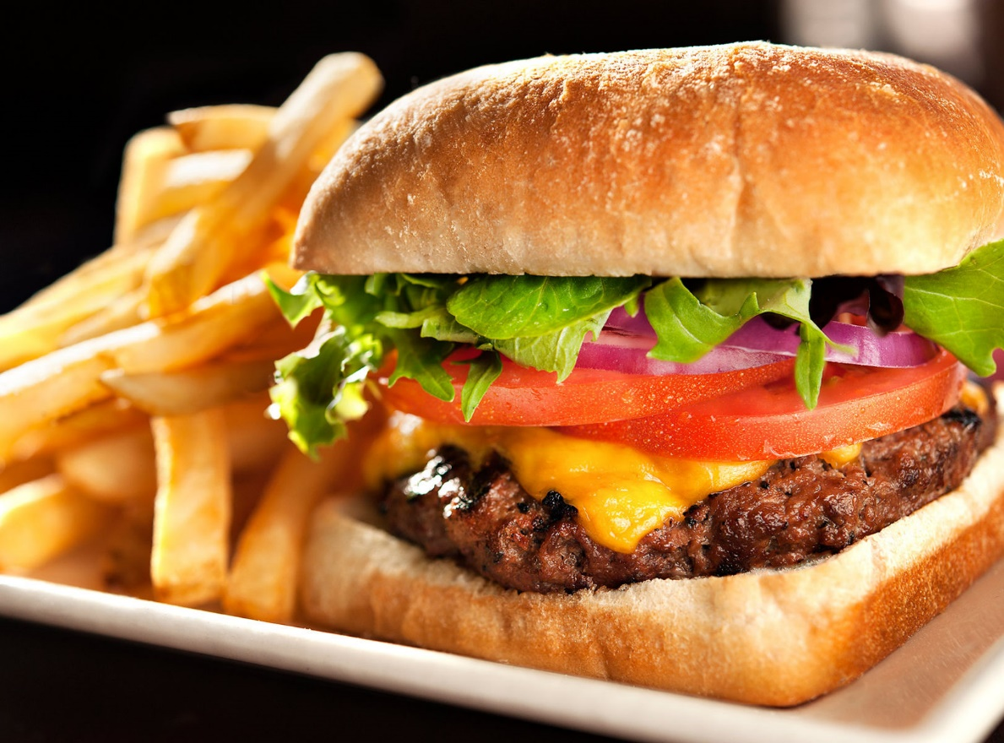
Waiter: And you? What would you like?
Pat: I’d like a hamburger and some fries, please.

Slide 6
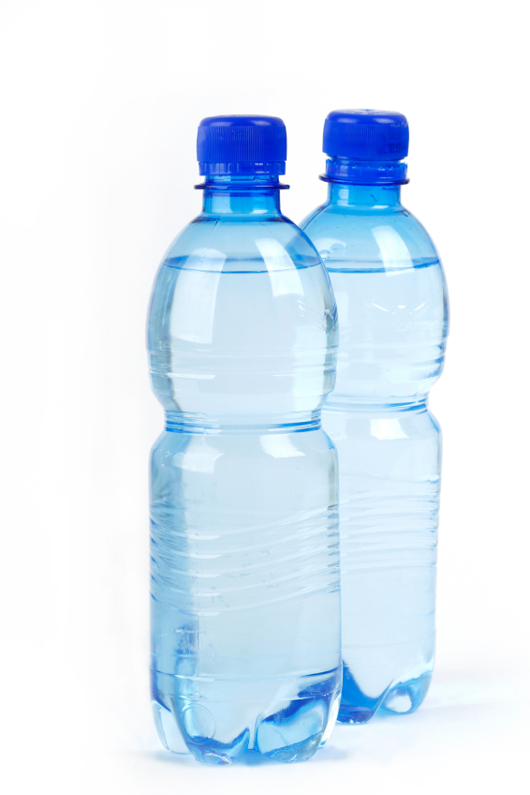
Waiter: And to drink?
Pat: Do you have any fruit juice?
Waiter: There isn’t any juice left. Sorry.
Pat: Well, just some water, then.
Waiter: Ok, I’ll bring your drinks right now.

Slide 7
A bowl of oatmeal.

Slide 8
Fruit salad is so healthy.

Slide 9
A bowl of stew, it’s delicious.

Slide 10
Meatballs.

Slide 11
Wine

Slide 12
Thank you ☺

Slide 13
Complete the following dialogue with the food from the images. Completa el siguiente dialogo con la comida de las imagenes.
Waiter: Good afternoon. Are you ready to order?
Dave: yes, I’ll have a _____________ and a cheese sandwich.
Waiter: Would you like anything to drink?
Dave: Yes, I’d like a glass of ________.
Waiter: And you? What would you like?
Bruce: I’d like ____________, please.
Waiter: What would you like to drink?
Bruce: I’d like a glass of __________too, please.
Waiter: Today we have a special promotion, so you’ll get a __________ for dessert for free.
Bruce and Dave: Great!

