Slide 1
ENGLISH WORKSHEET
Liceo José Victorino Lastarria
Rancagua
“Formando Técnicos para el mañana”
Unidad Técnico-Pedagógica
Departamento de Inglés
Semana del 7 al 11 de Septiembre
OA8. Demostrar conocimiento y uso del lenguaje en conversaciones, discusiones y exposiciones, por medio de las siguientes funciones:• solicitar y dar información sobre duración de una actividad; por ejemplo: how long have you been friends? (for)2 years/since 2010
Objetivo: Conocer y ejercitar uso del for-since.
Instrucciones: Analizar el uso de Since y for y responder ejercicios. Enviar respuestas a docente correspondiente:
Profesor Camilo Guarda: camiloguarda1989@gmail.com
Profesor Raúl López: lpez.raul@gmail.com

Slide 2
FOR
“FOR” is used for general periods of time. It’s to express duration.
- For three days
- For a week
- For several years
- For two centuries.
“I have learnt English for several years”

Slide 3
SINCE
'SINCE' is used for a starting point, a specific time.
- Since Monday
- Since 1997
- Since the last war
- Since the day we met

Slide 4
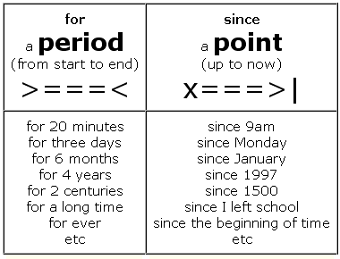

Slide 5
Write FOR or Since
1. | a week
2. | Monday
3. | Easter
4. | three months
5. | 3.30
6. | 1990
7. | ages (meaning: a long time)
8. | 10 minutes
9. | I was a child
10. | many years

Slide 6
Exit Ticket!
1. He has been here_____ a long period.
2. She has lived in New York ____ six years.
3. They have worked in the school_____ 1995.
4. Linda has been on holidays _____ six weeks.
5. He has been learning French _____ eight months.

